Slide 1
Overview of Meta-Analytic Data Analysis
Transformations, Adjustments and Outliers
The Inverse Variance Weight
The Mean Effect Size and Associated Statistics
Homogeneity Analysis
Fixed Effects Analysis of Heterogeneous Distributions
  Fixed Effects Analog to the one-way ANOVA
  Fixed Effects Regression Analysis
Random Effects Analysis of Heterogeneous Distributions
  Mean Random Effects ES and Associated Statistics
  Random Effects Analog to the one-way ANOVA
  Random Effects Regression Analysis
Practical Meta-Analysis -- D. B. Wilson
Notes:
Analysis Overheads

Slide 2
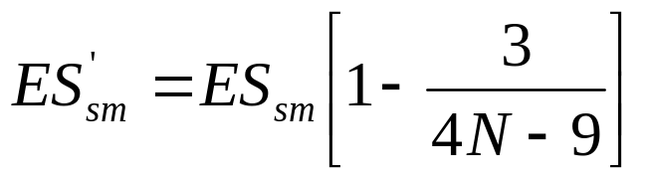
Transformations
Some effect size types are not analyzed in their “raw” form.
Standardized Mean Difference Effect Size
  Upward bias when sample sizes are small
  Removed with the small sample size bias correction
Practical Meta-Analysis -- D. B. Wilson
Notes:
Analysis Overheads

Slide 3
Transformations (continued)
Correlation has a problematic standard error formula.
Recall that the standard error is needed for the inverse variance weight.
Solution: Fisher’s Zr transformation.
Finally results can be converted back into “r” with the inverse Zr transformation (see Chapter 3).
Practical Meta-Analysis -- D. B. Wilson
Notes:
Analysis Overheads

Slide 4
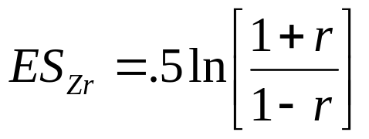
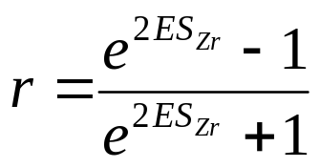
Transformations (continued)
Analyses performed on the Fisher’s Zr transformed correlations.
Finally results can be converted back into “r” with the inverse Zr transformation.
Practical Meta-Analysis -- D. B. Wilson
Notes:
Analysis Overheads

Slide 5
Transformations (continued)
Odds-Ratio is asymmetric and has a complex standard error formula.
  Negative relationships indicated by values between 0 and 1.
  Positive relationships indicated by values between 1 and infinity.
Solution: Natural log of the Odds-Ratio.
  Negative relationship < 0.
  No relationship = 0.
  Positive relationship > 0.
Finally results can be converted back into Odds-Ratios by the inverse natural log function.
Practical Meta-Analysis -- D. B. Wilson
Notes:
Analysis Overheads

Slide 6


Transformations (continued)
Analyses performed on the natural log of the Odds- Ratio:
Finally results converted back via inverse natural log function:
Practical Meta-Analysis -- D. B. Wilson
Notes:
Analysis Overheads

Slide 7
Adjustments
Hunter and Schmidt Artifact Adjustments
  measurement unreliability (need reliability coefficient)
  range restriction (need unrestricted standard deviation)
  artificial dichotomization (correlation effect sizes only)
    assumes an underlying distribution that is normal
Outliers
  extreme effect sizes may have disproportionate influence on analysis
  either remove them from the analysis or adjust them to a less extreme value
  indicate what you have done in any written report
Practical Meta-Analysis -- D. B. Wilson
Notes:
Analysis Overheads

Slide 8
Overview of Transformations, Adjustments, and Outliers
Standard transformations
  sample sample size bias correction for the standardized mean difference effect size
  Fisher’s Z to r transformation for correlation coefficients
  Natural log transformation for odds-ratios
Hunter and Schmidt Adjustments
  perform if interested in what would have occurred under “ideal” research conditions
Outliers
  any extreme effect sizes have been appropriately handled
Practical Meta-Analysis -- D. B. Wilson
Notes:
Analysis Overheads

Slide 9
Independent Set of Effect Sizes
Must be dealing with an independent set of effect sizes before proceeding with the analysis.
  One ES per study OR
  One ES per subsample within a study
Practical Meta-Analysis -- D. B. Wilson
Notes:
Analysis Overheads

Slide 10
The Inverse Variance Weight
Studies generally vary in size.
An ES based on 100 subjects is assumed to be a more “precise” estimate of the population ES than is an ES based on 10 subjects.
Therefore, larger studies should carry more “weight” in our analyses than smaller studies.
Simple approach: weight each ES by its sample size.
Better approach: weight by the inverse variance.
Practical Meta-Analysis -- D. B. Wilson
Notes:
Analysis Overheads

Slide 11
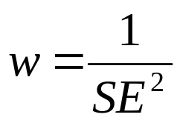
What is the Inverse Variance Weight?
The standard error (SE) is a direct index of ES precision.
SE is used to create confidence intervals.
The smaller the SE, the more precise the ES.
Hedges’ showed that the optimal weights for meta-analysis are:
Practical Meta-Analysis -- D. B. Wilson
Notes:
Analysis Overheads

Slide 12
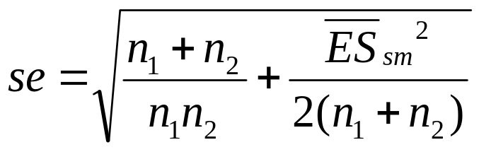
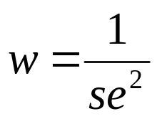
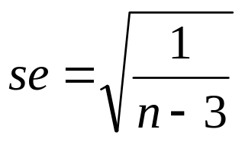

Inverse Variance Weight for the
Three Common Effect Sizes
Standardized Mean Difference:
Zr transformed Correlation Coefficient:
Practical Meta-Analysis -- D. B. Wilson
Notes:
Analysis Overheads

Slide 13
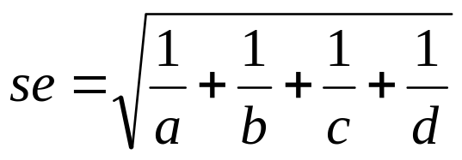
Inverse Variance Weight for the
Three Major League Effect Sizes
Logged Odds-Ratio:
Where a, b, c, and d are the cell frequencies of a 2 by 2 contingency table.
Practical Meta-Analysis -- D. B. Wilson
Notes:
Analysis Overheads

Slide 14
Ready to Analyze
We have an independent set of effect sizes (ES) that have been transformed and/or adjusted, if needed.
For each effect size we have an inverse variance weight (w).
Practical Meta-Analysis -- D. B. Wilson
Notes:
Analysis Overheads

Slide 15
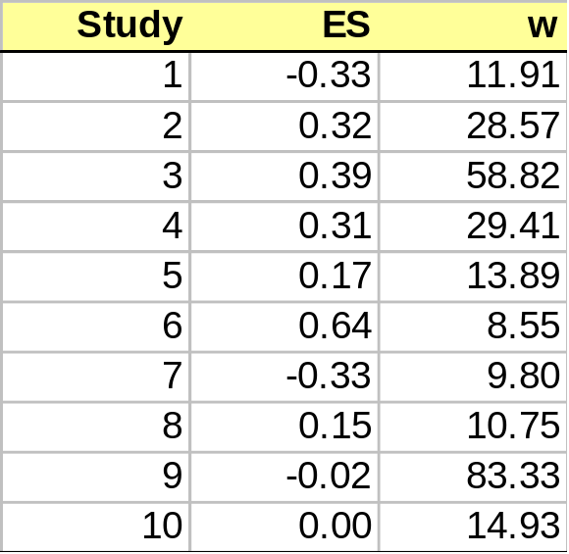
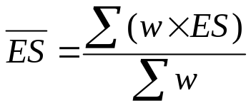
The Weighted Mean Effect Size
Start with the effect size (ES) and inverse variance weight (w) for 10 studies.
Practical Meta-Analysis -- D. B. Wilson
Notes:
Analysis Overheads

Slide 16
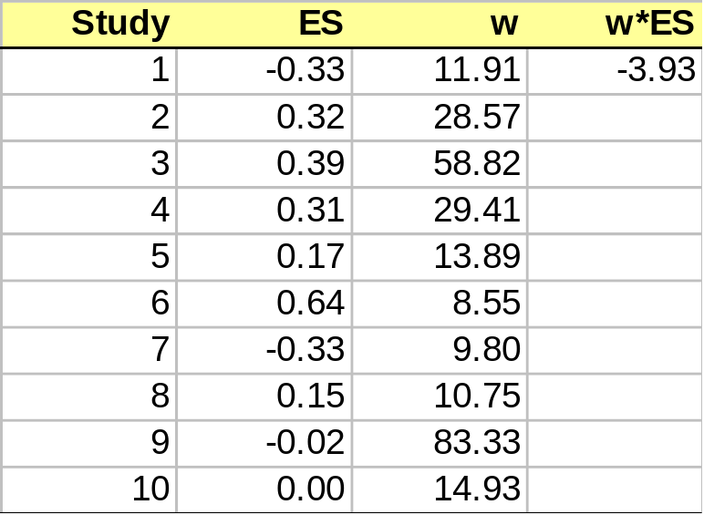
The Weighted Mean Effect Size
Start with the effect size (ES) and inverse variance weight (w) for 10 studies.
Next, multiply w by ES.
Practical Meta-Analysis -- D. B. Wilson
Notes:
Analysis Overheads

Slide 17
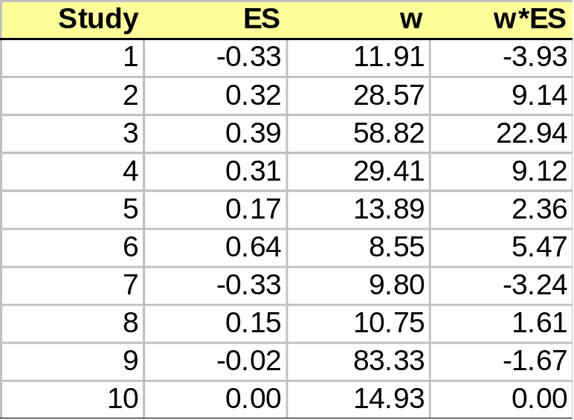
The Weighted Mean Effect Size
Start with the effect size (ES) and inverse variance weight (w) for 10 studies.
Next, multiply w by ES.
Repeat for all effect sizes.
Practical Meta-Analysis -- D. B. Wilson
Notes:
Analysis Overheads

Slide 18
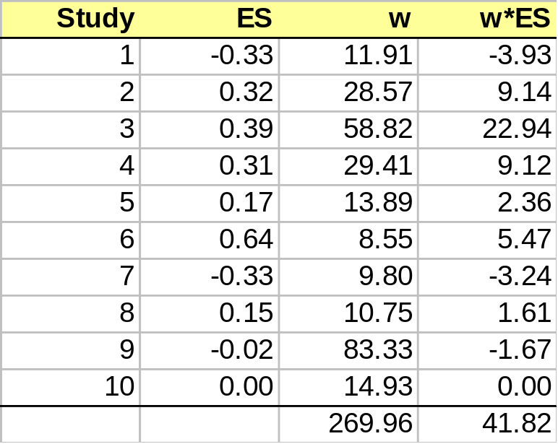
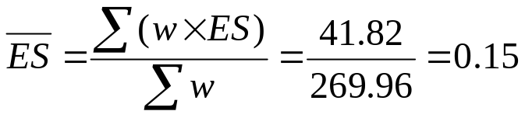
The Weighted Mean Effect Size
Start with the effect size (ES) and inverse variance weight (w) for 10 studies.
Next, multiply w by ES.
Repeat for all effect sizes.
Sum the columns, w and ES.
Divide the sum of (w*ES) by the sum of (w).
Practical Meta-Analysis -- D. B. Wilson
Notes:
Analysis Overheads

Slide 19
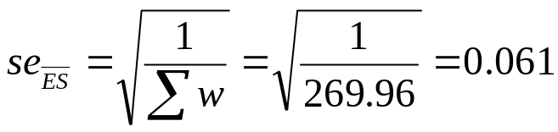
The Standard Error of the Mean ES
The standard error of the mean is the square root of 1 divided by the sum of the weights.
Practical Meta-Analysis -- D. B. Wilson
Notes:
Analysis Overheads

Slide 20
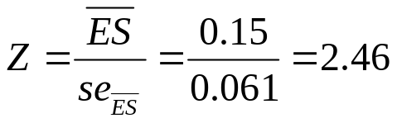
Mean, Standard Error,
Z-test and Confidence Intervals
Mean ES
SE of the Mean ES
Z-test for the Mean ES
95% Confidence Interval
Practical Meta-Analysis -- D. B. Wilson
Notes:
Analysis Overheads

Slide 21
Homogeneity Analysis
Homogeneity analysis tests whether the assumption that all of the effect sizes are estimating the same population mean is a reasonable assumption.
Assumption rarely reasonable
  Single mean ES not a good descriptor of the distribution
  There are real between study differences, that is, studies estimate different population mean effect sizes
  Random effects model addresses this issue
  You can also explore this excess variability with moderator analysis
Practical Meta-Analysis -- D. B. Wilson
Notes:
Analysis Overheads

Slide 22
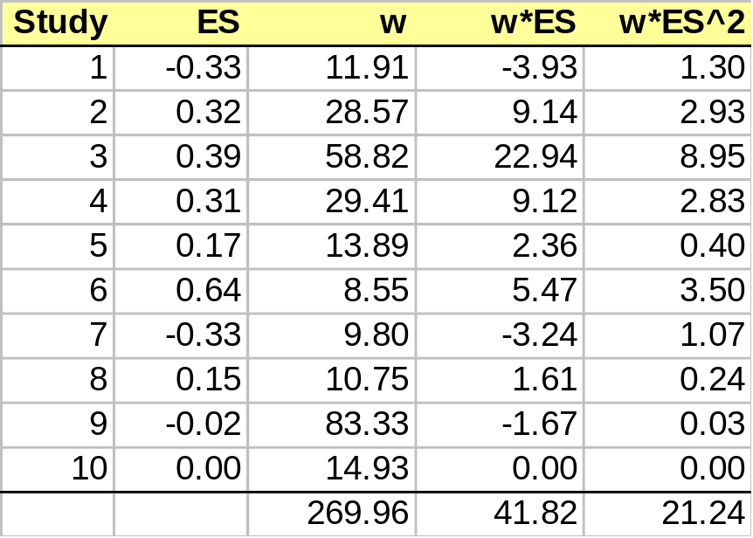
Q - The Homogeneity Statistic
Calculate a new variable that is the ES squared multiplied by the weight.
Sum new variable.
Practical Meta-Analysis -- D. B. Wilson
Notes:
Analysis Overheads

Slide 23
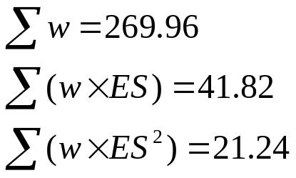
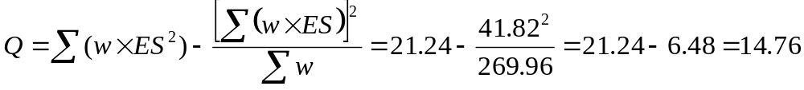
Calculating Q
We now have 3 sums:
Q is can be calculated using these 3 sums:
Practical Meta-Analysis -- D. B. Wilson
Notes:
Analysis Overheads

Slide 24
Interpreting Q
Q is distributed as a Chi-Square
df = number of ESs - 1
Running example has 10 ESs, therefore, df = 9
Critical Value for a Chi-Square with df = 9 and p = .05 is:
Since our Calculated Q (14.76) is less than 16.92, we fail to reject the null hypothesis of homogeneity.
Thus, the variability across effect sizes does not exceed what would be expected based on sampling error.
16.92
Practical Meta-Analysis -- D. B. Wilson
Notes:
Analysis Overheads

Slide 25
Heterogeneous Distributions: What Now?
Analyze excess between study (ES) variability
  categorical variables with the analog to the one-way ANOVA
  continuous variables and/or multiple variables with weighted multiple regression
Practical Meta-Analysis -- D. B. Wilson
Notes:
Analysis Overheads

Slide 26
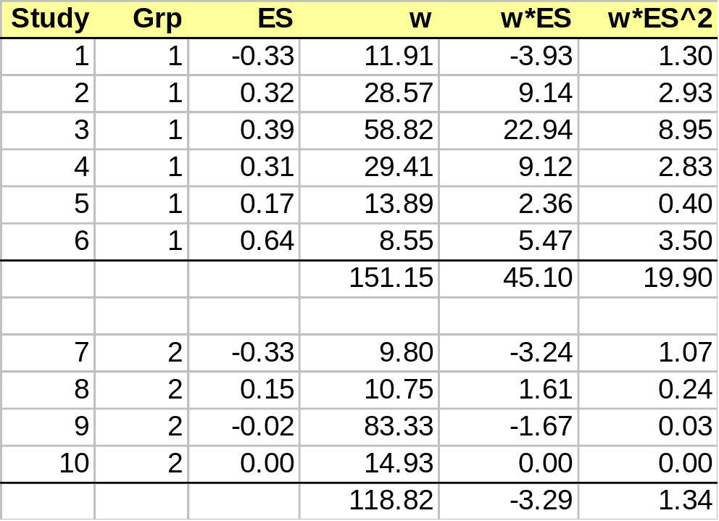
Analyzing Heterogeneous Distributions:
The Analog to the ANOVA
Calculate the 3 sums for each subgroup of effect sizes.
A grouping variable (e.g., random vs. nonrandom)
Practical Meta-Analysis -- D. B. Wilson
Notes:
Analysis Overheads

Slide 27
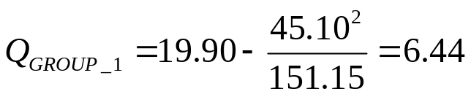
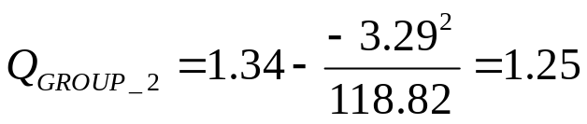
Analyzing Heterogeneous Distributions:
The Analog to the ANOVA
Calculate a separate Q for each group:
Practical Meta-Analysis -- D. B. Wilson
Notes:
Analysis Overheads

Slide 28



Analyzing Heterogeneous Distributions:
The Analog to the ANOVA
The sum of the individual group Qs = Q within:
Where k is the number of effect sizes
and j is the number of groups.
The difference between the Q total and the Q within
is the Q between:
Where j is the number of groups.
Practical Meta-Analysis -- D. B. Wilson
Notes:
Analysis Overheads

Slide 29
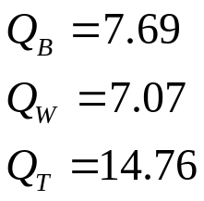
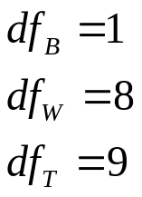
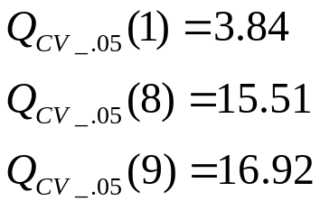
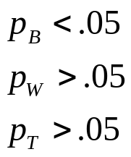
Analyzing Heterogeneous Distributions:
The Analog to the ANOVA
All we did was partition the overall Q into two pieces, a
within groups Q and a between groups Q.
The grouping variable accounts for significant variability
in effect sizes.
Practical Meta-Analysis -- D. B. Wilson
Notes:
Analysis Overheads

Slide 30
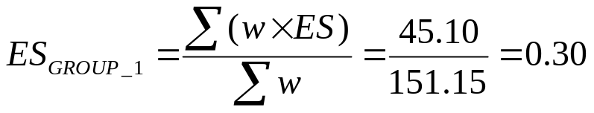
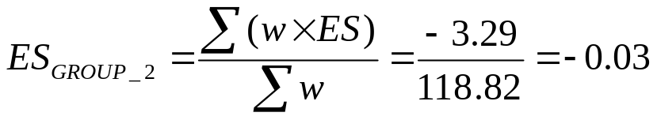
Mean ES for each Group
The mean ES, standard error and confidence intervals
can be calculated for each group:
Practical Meta-Analysis -- D. B. Wilson
Notes:
Analysis Overheads

Slide 31
Analyzing Heterogeneous Distributions:
Multiple Regression Analysis
Analog to the ANOVA is restricted to a single categorical between studies variable.
What if you are interested in a continuous variable or multiple between study variables?
Weighted Multiple Regression Analysis
  as always, it is weighted analysis
  can use “canned” programs (e.g., SPSS, SAS)
    parameter estimates are correct (R-squared, B weights, etc.)
    F-tests, t-tests, and associated probabilities are incorrect
  can use Wilson/Lipsey SPSS macros which give correct parameters and probability values
Practical Meta-Analysis -- D. B. Wilson
Notes:
Analysis Overheads

Slide 32
Meta-Analytic Multiple Regression Results
From the Wilson/Lipsey SPSS Macro
(data set with 39 ESs)
***** Meta-Analytic Generalized OLS Regression *****
------- Homogeneity Analysis -------
Q df p
Model 104.9704 3.0000 .0000
Residual 424.6276 34.0000 .0000
------- Regression Coefficients -------
B SE -95% CI +95% CI Z P Beta
Constant -.7782 .0925 -.9595 -.5970 -8.4170 .0000 .0000
RANDOM .0786 .0215 .0364 .1207 3.6548 .0003 .1696
TXVAR1 .5065 .0753 .3590 .6541 6.7285 .0000 .2933
TXVAR2 .1641 .0231 .1188 .2094 7.1036 .0000 .3298
Partition of total Q into variance explained by the regression “model” and the variance left over (“residual” ).
Interpretation is the same as will ordinal multiple regression analysis.
If residual Q is significant, fit a mixed effects model.
Practical Meta-Analysis -- D. B. Wilson
Notes:
Analysis Overheads

Slide 33
Review of Weighted
Multiple Regression Analysis
Analysis is weighted.
Q for the model indicates if the regression model explains a significant portion of the variability across effect sizes.
Q for the residual indicates if the remaining variability across effect sizes is homogeneous.
If using a “canned” regression program, must correct the probability values (see manuscript for details).
Practical Meta-Analysis -- D. B. Wilson
Notes:
Analysis Overheads

Slide 34
Random Effects Models
Don’t panic!
It sounds worse than it is.
Four reasons to use a random effects model
  Total Q is significant and you assume that the excess variability across effect sizes derives from random differences across studies (sources you cannot identify or measure)
  The Q within from an Analog to the ANOVA is significant
  The Q residual from a Weighted Multiple Regression analysis is significant
  It is consistent with your assumptions about the distribution of effects across studies
Practical Meta-Analysis -- D. B. Wilson
Notes:
Analysis Overheads

Slide 35
The Logic of a
Random Effects Model
Fixed effects model assumes that all of the variability between effect sizes is due to sampling error
  In other words, instability in an effect size is due simply to subject-level “noise”
Random effects model assumes that the variability between effect sizes is due to sampling error plus variability in the population of effects (unique differences in the set of true population effect sizes)
  In other words, instability in an effect size is due to subject-level “noise” and true unmeasured differences across studies (that is, each study is estimating a slightly different population effect size)
Practical Meta-Analysis -- D. B. Wilson
Notes:
Analysis Overheads

Slide 36
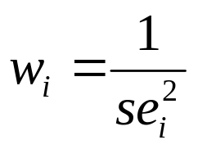
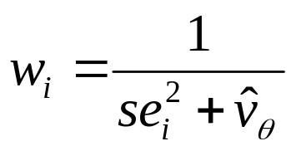
The Basic Procedure of a
Random Effects Model
Fixed effects model weights each study by the inverse of the sampling variance.
Random effects model weights each study by the inverse of the sampling variance plus a constant that represents the variability across the population effects.
This is the random effects variance
component.
Practical Meta-Analysis -- D. B. Wilson
Notes:
Analysis Overheads

Slide 37
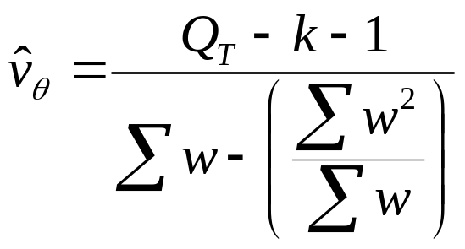
How To Estimate the Random
Effects Variance Component
The random effects variance component is based on Q.
The formula is:
Practical Meta-Analysis -- D. B. Wilson
Notes:
Analysis Overheads

Slide 38
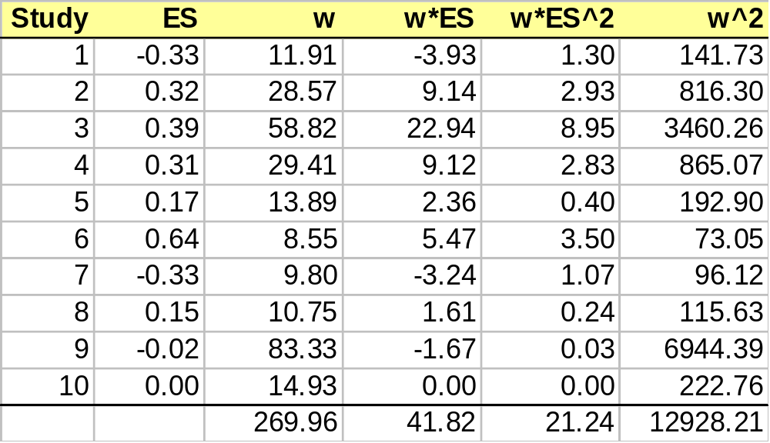
Calculation of the Random
Effects Variance Component
Calculate a new variable that is the w squared.
Sum new variable.
Practical Meta-Analysis -- D. B. Wilson
Notes:
Analysis Overheads

Slide 39
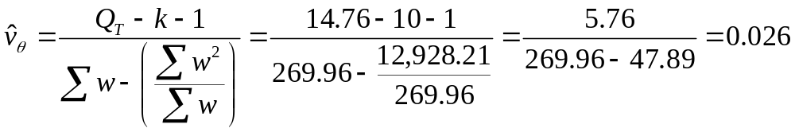
Calculation of the Random
Effects Variance Component
The total Q for this data was 14.76
k is the number of effect sizes (10)
The sum of w = 269.96
The sum of w2 = 12,928.21
Practical Meta-Analysis -- D. B. Wilson
Notes:
Analysis Overheads

Slide 40
Rerun Analysis with New
Inverse Variance Weight
Add the random effects variance component to the variance associated with each ES.
Calculate a new weight.
Rerun analysis.
Congratulations! You have just performed a very complex statistical analysis.
Note: Macros do this for you. All you need to do is specify “model = mm” or “model = ml”
Practical Meta-Analysis -- D. B. Wilson
Notes:
Analysis Overheads

Slide 41
Random Effects Variance Component for the Analog to the ANOVA and Regression Analysis
The Q between or Q residual replaces the Q total in the formula.
Denominator gets a little more complex and relies on matrix algebra. However, the logic is the same.
SPSS macros perform the calculation for you.
Practical Meta-Analysis -- D. B. Wilson
Notes:
Analysis Overheads

Slide 42
SPSS Macro Output with Random Effects
Variance Component
***** Inverse Variance Weighted Regression *****
***** Random Intercept, Fixed Slopes Model *****
------- Descriptives -------
Mean ES R-Square k
.1483 .2225 38.0000
------- Homogeneity Analysis -------
Q df p
Model 14.7731 3.0000 .0020
Residual 51.6274 34.0000 .0269
Total 66.4005 37.0000 .0021
------- Regression Coefficients -------
B SE -95% CI +95% CI Z P Beta
Constant -.6752 .2392 -1.1439 -.2065 -2.8233 .0048 .0000
RANDOM .0729 .0834 -.0905 .2363 .8746 .3818 .1107
TXVAR1 .3790 .1438 .0972 .6608 2.6364 .0084 .3264
TXVAR2 .1986 .0821 .0378 .3595 2.4204 .0155 .3091
------- Method of Moments Random Effects Variance Component -------
v = .04715
Random effects variance component based on the residual Q.
Practical Meta-Analysis -- D. B. Wilson
Notes:
Analysis Overheads

Slide 43
Comparison of Random Effect with
Fixed Effect Results
The biggest difference you will notice is in the significance levels and confidence intervals.
  Confidence intervals will get bigger.
  Effects that were significant under a fixed effect model may no longer be significant.
Random effects models are therefore more conservative.
If sample size is highly related to effect size, then the mean effect size will differ between the two models
Practical Meta-Analysis -- D. B. Wilson
Notes:
Analysis Overheads

Slide 44
Review of Meta-Analytic Data Analysis
Transformations, Adjustments and Outliers
The Inverse Variance Weight
The Mean Effect Size and Associated Statistics
Homogeneity Analysis
Fixed Effects Analysis of Heterogeneous Distributions
  Fixed Effects Analog to the one-way ANOVA
  Fixed Effects Regression Analysis
Random Effects Analysis of Heterogeneous Distributions
  Mean Random Effects ES and Associated Statistics
  Random Effects Analog to the one-way ANOVA
  Random Effects Regression Analysis
Practical Meta-Analysis -- D. B. Wilson
Notes:
Analysis Overheads

